Slide 1
The Effectiveness of Norway’s 2004 Smoking Ban
A Difference-in-Differences Analysis
Amadeus Linge & Ulrik Haugland
Notes:
Ami

Slide 2
Agenda
Research question
01.
The research question we are investigating using econometrics and causal inference
Policy
02.
The policy we are trying to evaluate in this project
Ideal experiment
03.
How the ideal experiment would look like for us to get the best evaluation
Our analysis
04.
How we did the research given limitation and lack of data
Results & Conclusions
05.
What we found from the research and our evaluation
Notes:
ulli

Slide 3
Agenda
The research question
The policy
The Ideal Experiment
Our analysis
Main results
Limitations
Conclusion

Slide 4
Did Norway's comprehensive smoking ban in 2004 reduce smoking rates compared to Spain?
Norway implemented a comprehensive smoking ban in 2004
Spain did not implement a similar ban on smoking before 2011 and serves as the control group in this analysis
Did the ploicy work in decreasing smoking?

Slide 5
Did Norway’s indoor smoking ban in 2004 reduce smoking rates compared to Spain?
01
Public indoor smoking ban 2004 for Norway
02
Spain banned it in 2011
Because Spain lagged in banning, it serves as a control group
03
Did it decrease smoking
Tobacco prices as control variable
Norway has seen a bigger increase in tobacco tax rate
04
Notes:
Ulli

Slide 6
Norway’s 2004 Smoking Ban
Comprehensive ban on smoking in public places
Restaurants, bars, workplaces
One of the first comprehensive bans in Europe

Slide 7

The ‘Gold Standard’ Experiment
Randomized controlled trial
Randomly assign smoking bans to some countries
Keep others as controls
Measure smoking rates before and after
Compare treatment vs. control groups
Control group
Treatment group
Notes:
Ami

Slide 8
The ‘Gold Standard’ Experiment
1. Randomly assign smoking bans to some countries
2. Keep others as controls
3. Measure smoking rates before and after
4. Compare treatment vs. control groups
Problem: We can't randomly assign policies to countries!

Slide 9
Difference-in-Difference (DiD) Design
Treatment
Norwegian smoking rates 2000-2004
No comprehensive indoor smoking ban
Includes tobacco prices
Assumes trend is parallel to Spain
Norwegian smoking rates 2004-2010
Comprehensive indoor smoking ban
Includes tobacco prices
For significant results smoking rates must be significantly different now from spanish smoking rates
Control
Spanish smoking rates 2000-2004
No comprehensive indoor smoking ban
Includes tobacco prices
Assumes trend is parallel to Norway
Spanish smoking rates 2004-2010
No comprehensive indoor smoking ban
Includes tobacco prices
For significant results smoking rates must be significantly different now from norwegian smoking rates
Pre-treatment
2004
Post-treatment
Market share
Notes:
Ulli

Slide 10
Difference-in-Difference (DiD) Design
Treatment Group: Norway (got smoking ban in 2004)
Control Group: Spain (no ban in 2004)
Before Period: 2000-2003
After Period: 2004-2010
Key Assumption: Norway and Spain would have
followed similar trends without the policy (parallel trends assumption)

Slide 11



Data Sources and Description
Statistisk Sentralbyrå
Open-source statistics
Archivos de Bronconeumologia
Paper on Spanish tobacco consumption
Federal Reserve Bank of St.Louis
Open-source statistics
Daily smokers in Norway
Has the Reduction in Tobacco Consumption in Spain Stopped? No, But We Have To Speed It Up
Haromonized Index of Consumer Prices
Notes:
Ami

Slide 12
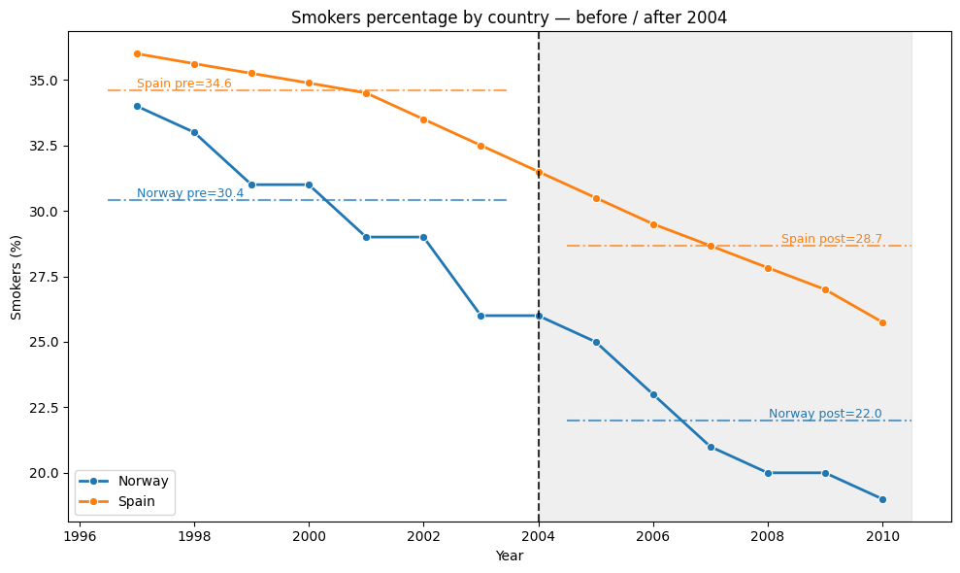
Notes:
Ulli

Slide 13
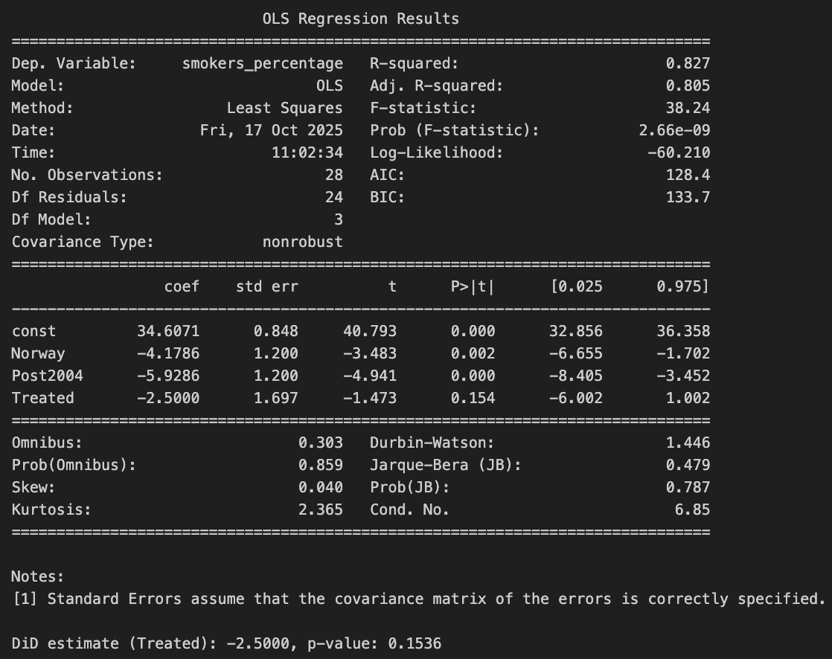
DiD table
T-test with 5% significance level
No control variable
Using normal standard errors
Notes:
Ami

Slide 14
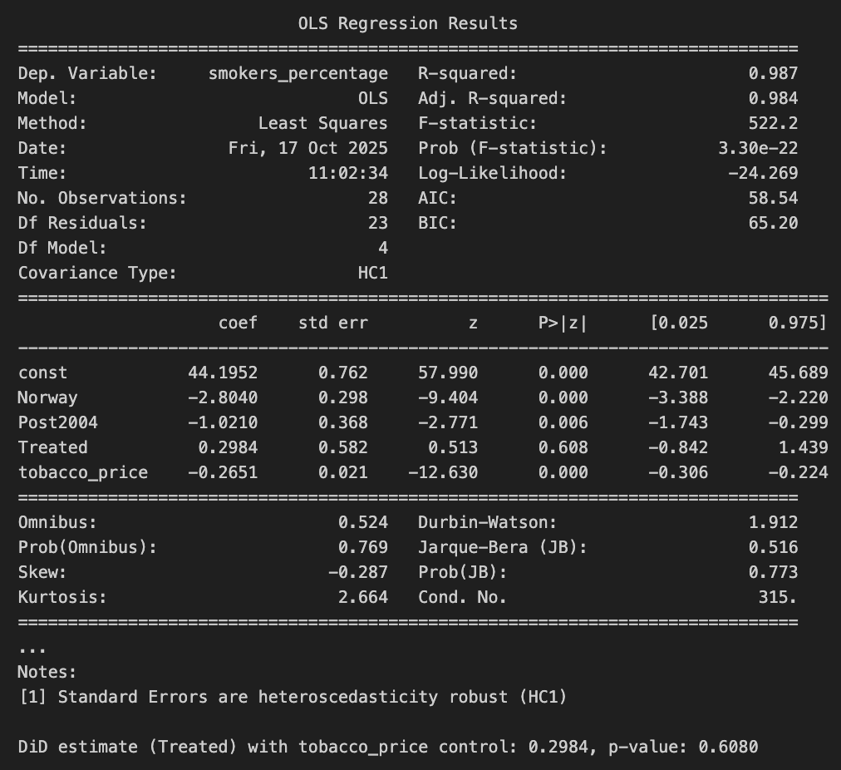
DiD table
With control variable tobacco prices
Difference in tobacco prices for Spain and Norway
Notes:
Ami

Slide 15
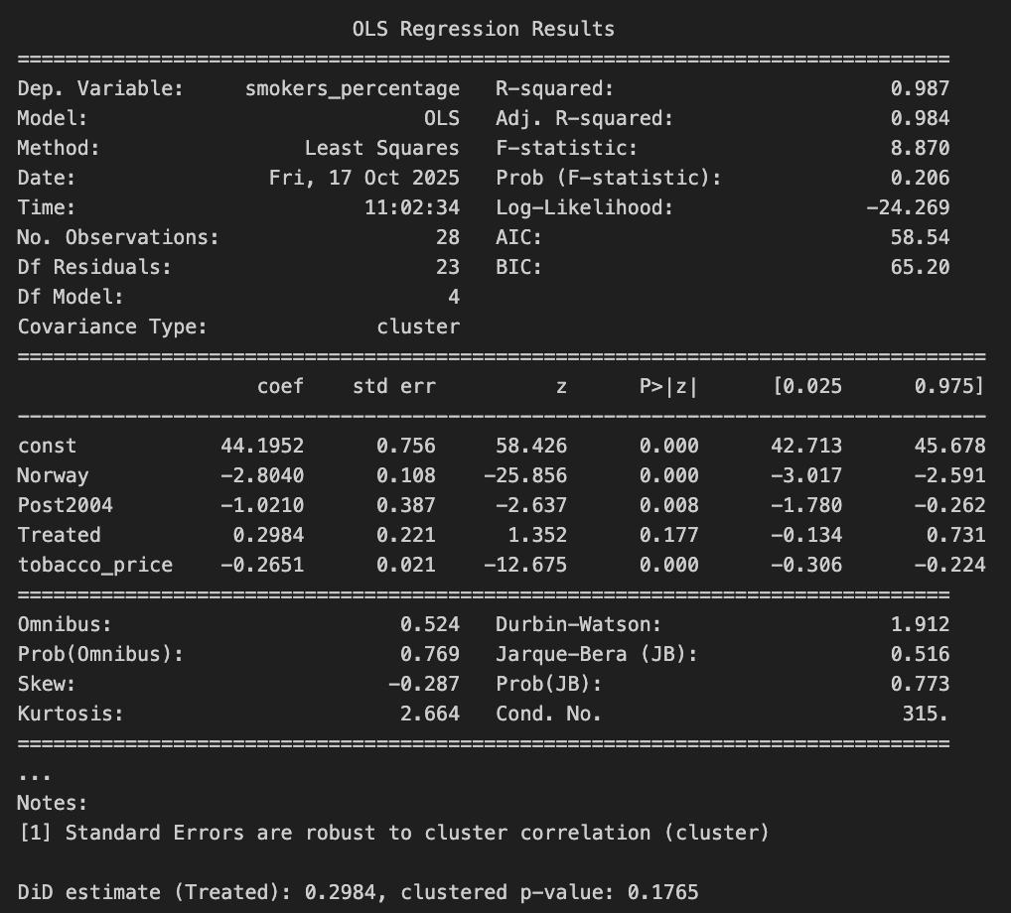
DiD table
With control variable tobacco prices
Difference in tobacco prices for Spain and Norway
With clustered standard errors
We need to use this as we have serial correlation in the data
The smoking rate this year is correlated with the smoking rate last year
Notes:
Ulli

Slide 16
Data Description
Data on smoking in Norway is collected from ssb (Statistisk Sentralbyrå) and shows percentage of responders that smokes daily
Similar data is collected for smoking in Spain from ………..

Slide 17
Our Results: Summary Statistics

Slide 18
Conclusion
Decline in smoking rate
Faster for Norway than Spain
Could the smoking ban of 2004 explain why Norway has a lower smoking rate than other countries
DiD regression Results were non-siginificant which means we cannot disregard the zero hypothesis
Increases in tobacco prices
Faster for Norway than Spain
We control for the fact that Norway has seen higher increases in tobacco prices then most other countries
Later indoor smoking ban
Norway 2004, Spain 2011
Spain serves as a great control group as they are also a European country, but lagged in the implementation of the indoor smoking ban
Keywords: text box, boxes, consequence, consequences, result, results

Slide 19


Robustness check
Pros
Cons
Both groups are European countries
More uncertainty around the Spanish smoker's data
Hard to find data
Parallel trends assumption holds
Maybe too great cultural difference between Northern Europe and Southern Europe
Different attitudes to alcohol and tobacco
Snus not present in Southern Europe
Underlying world trend for decline in smoking
Notes:
Ulli

Slide 20
Conclusion
Decline in smoking rate
Faster for Norway than Spain
DiD regression Results were non-significant.
We cannot disregard the zero hypothesis
Increases in tobacco prices
Faster for Norway than Spain
Later indoor smoking ban
Norway 2004, Spain 2011
Keywords: text box, boxes, consequence, consequences, result, results
Notes:
Ulli

Slide 21
Main Findings

Slide 22
Robustness check
Paralell trends
Placebo test

Slide 23
Interpretation of the Findings

Slide 24
Limitations

Slide 25
Conclusion

